Slide 1
India Geography and Languages

Slide 2
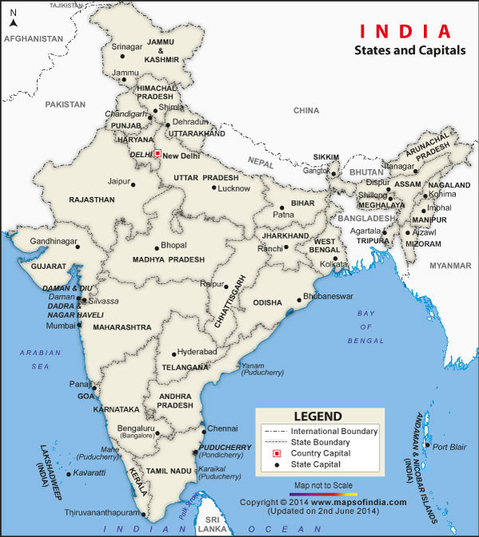

Slide 3
About India
The name India (pronounced is derived from Indus, which is derived from the Old Persian word Hindu, from Sanskrit सिन्Sindhu.
Seventh largest country in the world
29 states and 7 Union territories
New Delhi is the capital of India
Hindi, English, 16 other languages are official languages
Concept of Zero, decimal numbers, game of Chess, concept of atom was discovered in India

Slide 4
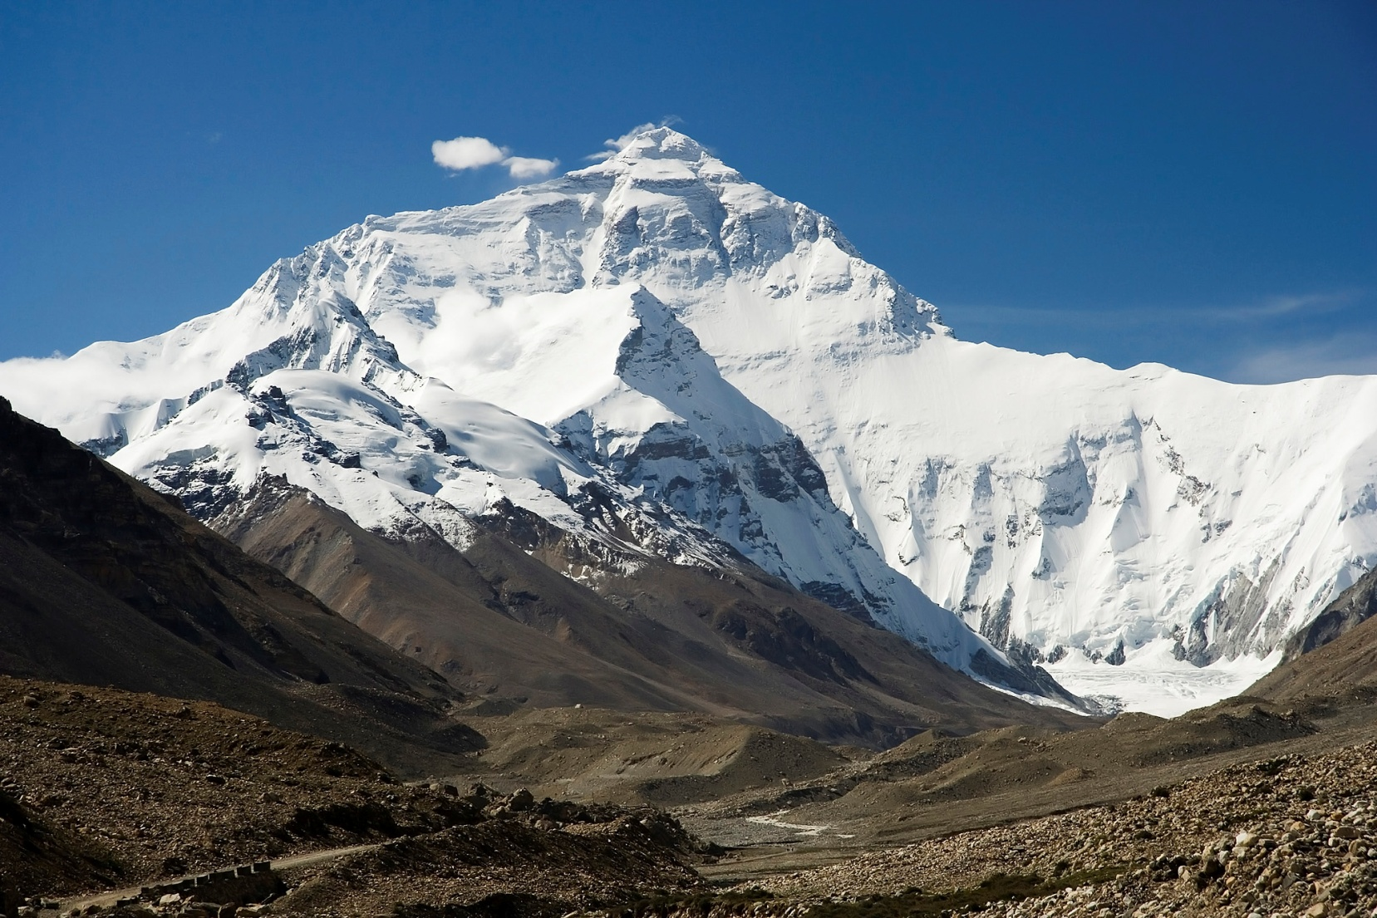
Himalayas in the North
Mt. Everest is a part of the Himalayas

Slide 5
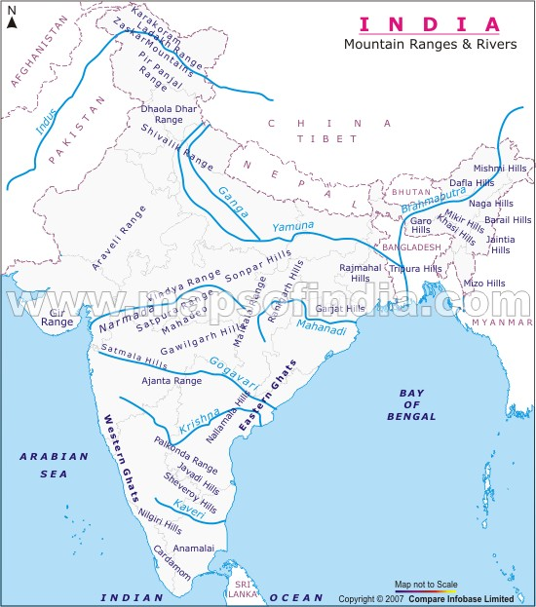
Surrounded by Himalayas on one side and sea/Ocean on 3 sides- Bay of Bengal, Arabian sea and Indian Ocean.
9 main rivers flow through India
Ganges is the largest river of India
Pakistan, Nepal, China, Mayanmar and Bangladesh are our neighbors.

Slide 6
Climate of India
Northern India, especially in the Himalayas, has seasonal temperatures with cool winters.
Most of southern India, particularly inland, is hot and dry. Temperatures can reach as high as 120 degrees Fahrenheit.
Monsoons during June through September produce severe storms with rain. The western and north-eastern coasts hit by monsoons get considerable rain, some areas getting over 100 inches per year.

Slide 7
India’s contribution to the world
Concept of Zero:
India invented the Number System. Zero was invented by Aryabhatta.
Decimal numbers
Game of Chess
Concept of Atom
Time taken by the earth to orbit the sun :
Bhaskaracharya calculated the time taken by the earth to orbit the sun hundreds of years before the astronomer Smart.; Time taken by earth to orbit the sun: (5th century) 365.258756484 days.
"Many of the advances in the sciences that we consider today to have been made in Europe were in fact made in India centuries ago."
- Grant Duff
British Historian of India

Slide 8
Languages of India
The principal official language of the Republic of India is Hindi, while English is the secondary official language
29 languages are spoken in India
Sanskrit, the classical language of India, represents the highest achievement of the Indo-Aryan Languages. The bIt is the oldest literary language of India, which is more than 5,000 years old and the basis of many modern Indian languages including Hindi and Urdu. All the classical literature and the Indian epics have been written in Sanskrit.
The principal languages with rich literary heritage are :- Assamese, Bengali, English, Gujarati, Hindi, Kannada, Kashmiri, Malayalam, Marathi, Oriya, Punjabi, Sanskrit, Sindhi, Tamil, Telugu and Urdu.

Slide 9
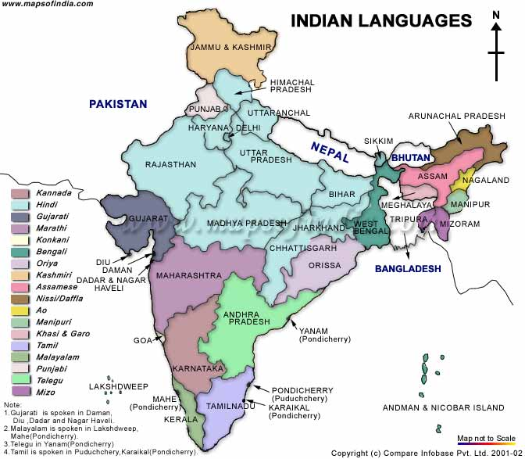
Languages of India

